Slide 1
Help transform an abandoned warehouse into affordable housing for local young people

Slide 2
Exeter has a challenging housing crisis. There is limited one-bed accommodation for local young people. In2018, only 1 in4 young people were able to receive the long-term housing they needed.

Slide 3
YMCA Exeter has a vision to support young people to become embedded in their communities. Many of their young people have been with them for many years and are ready to move on into independent living, but although they have meaningful occupations they are priced out of traditional rented housing. They have nowhere to go.

Slide 4
Watch this film

Slide 5
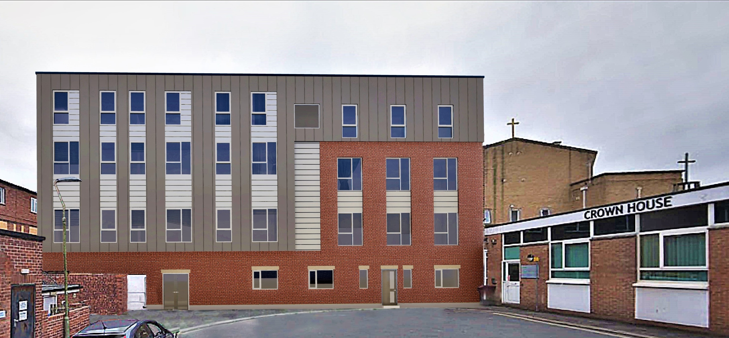
YMCA Exeter is tackling this problem by taking an abandoned warehouse near the city centre and transforming it into 26 self-contained studio apartments. Each apartment will provide a young person with a permanent, affordable home and support if needed.

Slide 6
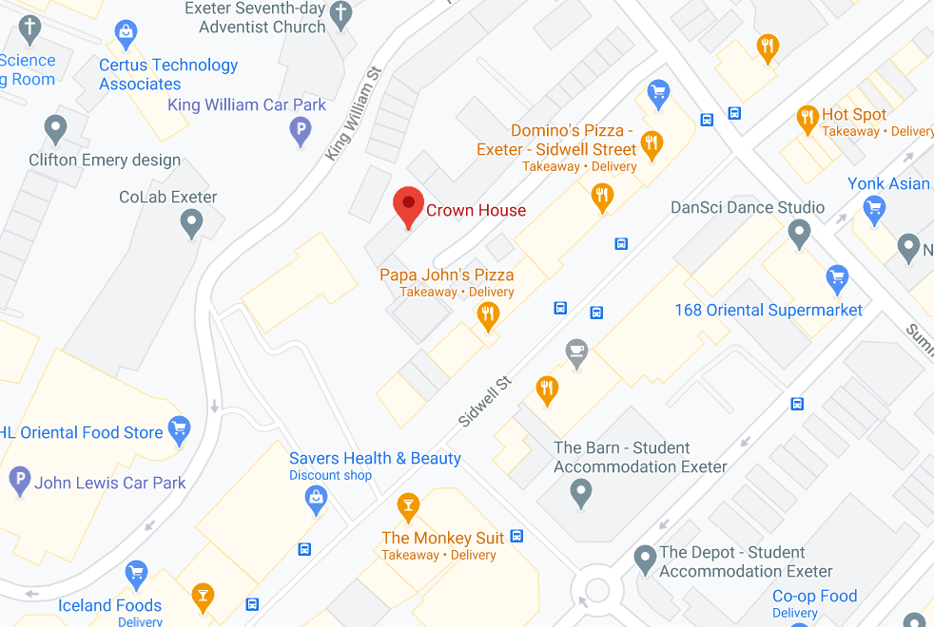
Sidwell Studios is being specifically built to create a fantastic community feel within the wider community, regenerating the area and providing an asset to the locality and real, affordable housing options for local young people where they will never have to pay a deposit or rent up-front.

Slide 7
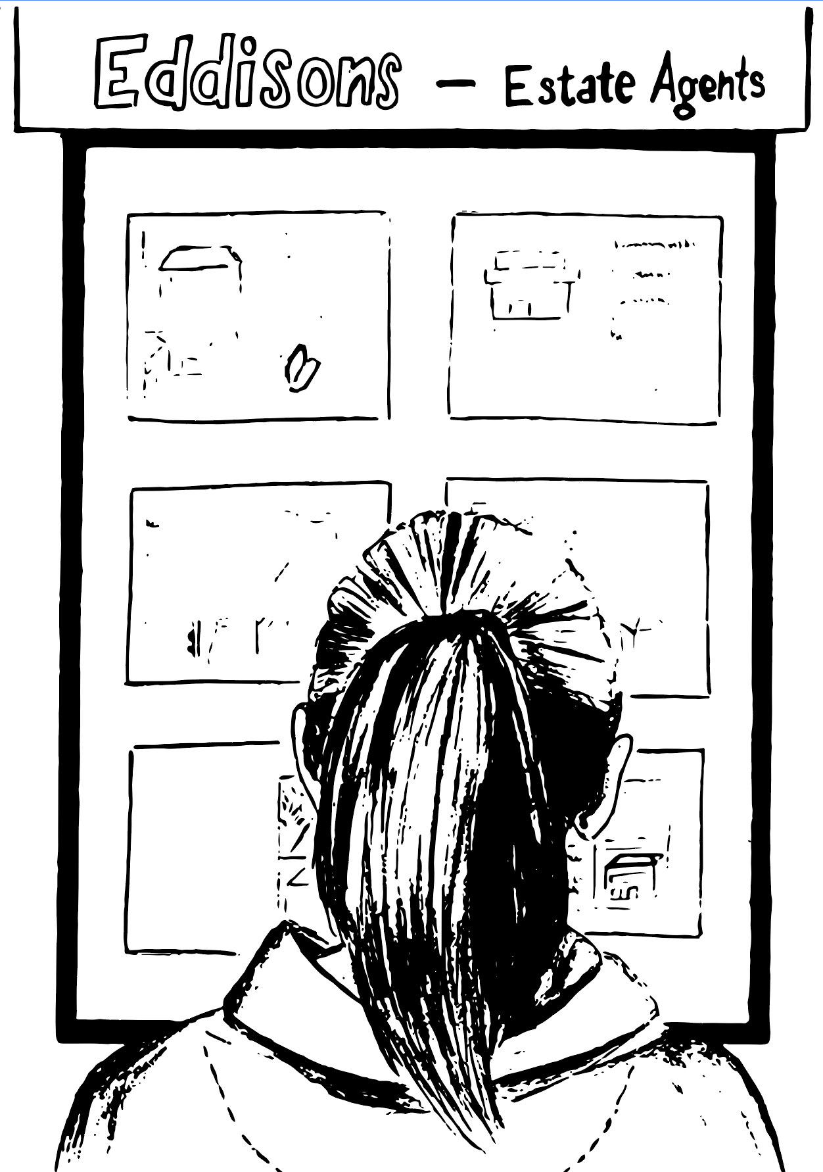
.
GEMMA’S STORY
“A few years ago I started looking for a 1-bed flat to move into by myself as I felt like it was time to move out of my parents, but it was impossible to find anything that I could afford to rent.
I’ve been living in YMCA Exeter stage two accommodation since November 2019. I feel really lucky to be here. My YMCA Exeter support worker has been amazing. She’s helped me to be assessed for learning difficulties and I’ve been able to start an Open University degree in childcare. I never imagined I’d be able to get a degree.
I was working at the beginning of lockdown, but when my contract came to an end I’ve struggled to find long-term work. I can only get short-term contracts. There’s no way I’d be able to find somewhere to rent without a full-time job.
Sometimes I feel really stuck. But this new housing project at YMCA Exeter gives me hope. To know that there is the potential of a flat in the centre of town that I could afford would be amazing.”

Slide 8
.
JACKSON’S STORY
“As lockdown hit, my partner of two years broke up with me and I suddenly found myself homeless. Normally I’d move into someone else's house but because of lockdown no-one would let me stay. Three weeks later I was able to move into a shared house at YMCA Exeter Supported Accommodation.
Before lockdown I had never claimed benefits and didn’t even know supported accommodation existed. I’ve looked into 1-bed housing but it’s so expensive. I can’t afford it on universal credit. Once I’d have paid my rent I’d be skint for the next three weeks.
I’ve decided I’m going to go to uni and study Investment Banking. I want to challenge myself to do it and I know I can.”

Slide 9
.
“By wisdom a house is built, and through
understanding it is established; through knowledge its rooms are filled with rare and beautiful treasures.”
^{Proverbs 24:3-4}

